Slide 1

ADITYA INSTITUTE OF TECHNOLOGY AND MANAGEMENT
DEPARTMENT OF COMPUTER SCIENCE AND ENGINEERING
(Approved by AICTE permanently affiliated to JNTUGV, Vizianagaram,
Accredited by NBA & NAAC with A+) K.Kotturu,tekkali-532201

Slide 2
Cognito Track – AI Based Early Dementia Detection
Under the Guidance of Dr. CH. Ramesh
Team Members:
Name
Roll Number
Bishwanath Bhandari
22A51A05K0
K MadhuSudhan Rao
22A51A05F5
S Shiva Sai
22A51A05I7
M.Manikantha
22A51A05G2
Y.Santu Sai
22A51A05J8

Slide 3
TABLE OF CONTENT
Abstract
Introduction
Literature & Survey
Methodology
Gaps in Existing Literature
Proposed Solution
Graphs
Conclusion

Slide 4
Abstract:
Dementia is a progressive brain condition that affects memory, thinking, and behavior, mostly in older adults. It often goes unnoticed in its early stages, making treatment less effective later. Early detection is crucial to manage symptoms and improve quality of life. Cognito Track is an AI-based system designed to detect early signs of dementia by passively monitoring users' interactions with smart devices like smartphones, tablets, and voice assistants. It observes subtle behavior changes such as , navigation patterns, speech hesitation, and routine shifts. These patterns are converted into meaningful data and analyzed using machine learning models like LSTMs and Transformers to detect anomalies over time. The system uses federated learning and on-device processing to ensure privacy—user data never leaves the device. By building a personal behavior baseline and identifying deviations, Cognito Track can alert users or caregivers early, enabling timely medical attention and supporting preventive digital healthcare.

Slide 5
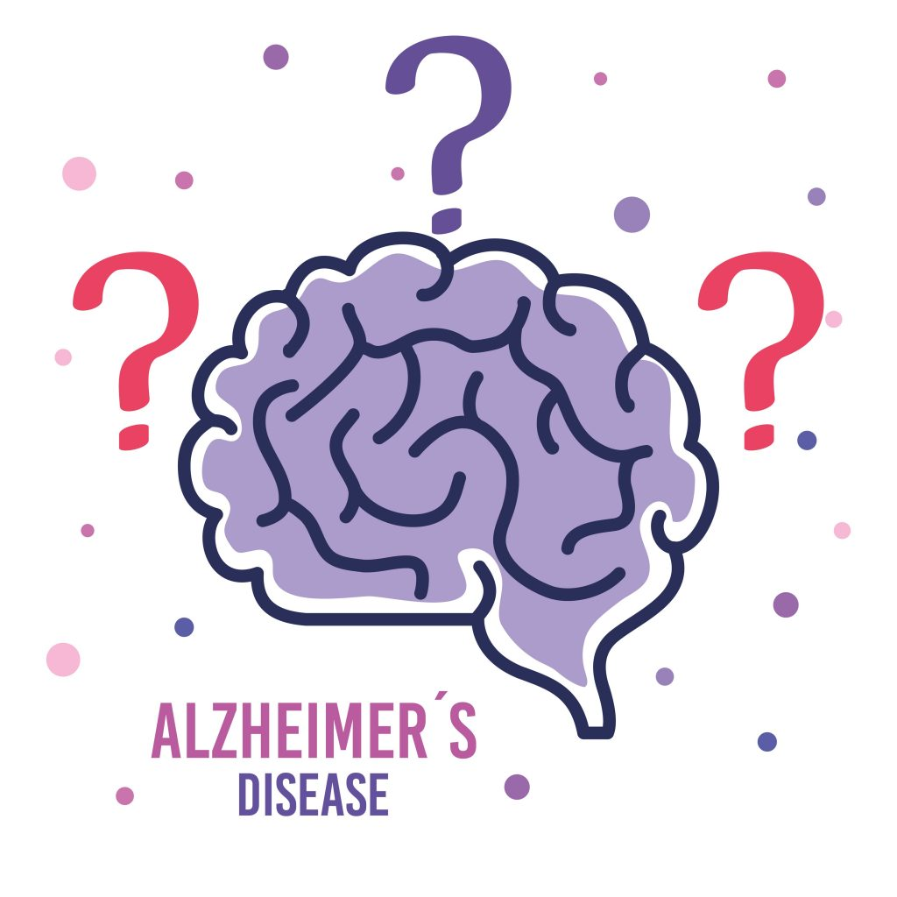
Introduction:
Dementia is a progressive brain condition. It’s a group of symptoms that affect memory, thinking, behavior, and the ability to perform daily activities. It happens when brain cells are damaged and can no longer communicate properly.
The most common cause is Alzheimer’s disease, but there are other types like Vascular dementia and Lewy body dementia.
Crucially, it often goes unnoticed in its early stages, significantly limiting the effectiveness of treatment.
Early detection is vital for managing symptoms, improving the quality of life for patients, and enabling timely medical intervention.

Slide 6
Literature & Survey:
Author(s) & Year | Methodology | Remark | Results
Ntracha et al., 2020 Frontiers in Digital Health | Collected natural typing data; analyzed keystroke dynamics using machine learning to identify mild cognitive impairment. | First real-world evidence linking typing speed, latency, and errors to cognitive decline. | Demonstrated ~80% accuracy in distinguishing MCI from healthy controls using passive keystroke data.
Liang et al., 2021 – Voice Assistant Command Dataset | Captured Alexa/voice-assistant command audio; extracted acoustic and linguistic features to detect dementia cues. | Innovative use of smart home voice interactions for dementia detection. | Speech hesitation and reduced lexical diversity predicted cognitive decline with promising accuracy (~78%).
Nguyen et al., 2023 – Smartphone Keystroke Review | Systematic review of keystroke-based digital biomarkers across mobile and PC platforms. | Summarized feature engineering methods (dwell, flight, pause time) and data collection designs. | Identified consistent correlations between slower typing rhythm and cognitive impairment severity.
Park et al., 2024 – JMIR / Sensors | Developed “NeuroKeys” smartphone keyboard app; collected real typing data; applied deep learning for classification. | Real-world mobile study integrating behavioral and cognitive analytics. | Demonstrated >85% accuracy in distinguishing early cognitive decline; proved smartphone-based monitoring is feasible.

Slide 7
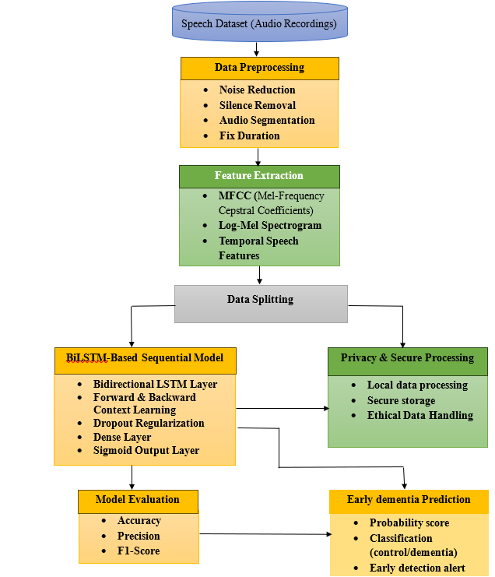
Methodology:

Slide 8
Gaps in Existing Literature:
Used small, non-speaker-wise datasets Same person’s voice appeared in both train and test → false high accuracy.
Focused only on handcrafted features (MFCC, pitch, energy) These miss long-term speech behavior like pauses, hesitation, slow speech.
Used CNN or traditional ML (SVM, Random Forest) CNN sees images, but speech is a time sequence → temporal behavior ignored.
No real-time application Most papers stop at accuracy numbers. No usable system for patients/doctors.
No clear mapping from speech behavior to dementia symptoms Models predict, but don’t relate to real dementia speech patterns.

Slide 9
Proposed Solutions:
Speaker-wise train/test split
Prevents data leakage → realistic accuracy.
Log-Mel Spectrogram used as time sequence (64×300)
Preserves full speech dynamics instead of small feature vectors.
BiLSTM for temporal speech learning
Learns pauses, hesitation, slow speech — real dementia indicators.
End-to-end system (Model + Flask Web App)
User can upload speech and get instant result.
Model trained on behavioral speech patterns over time.
Closer to how neurologists observe dementia.

Slide 10
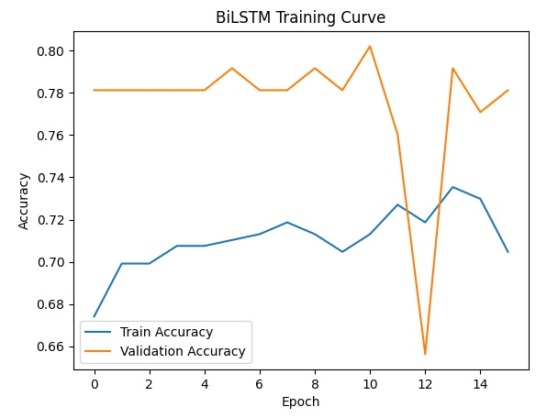
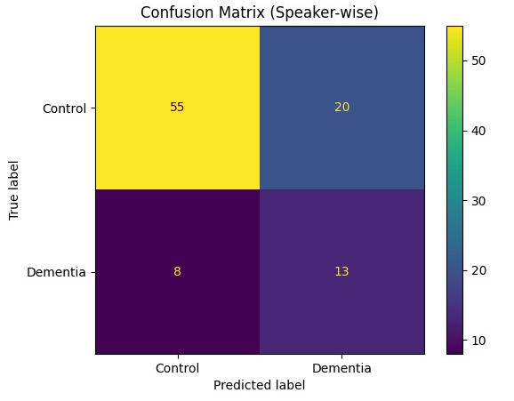
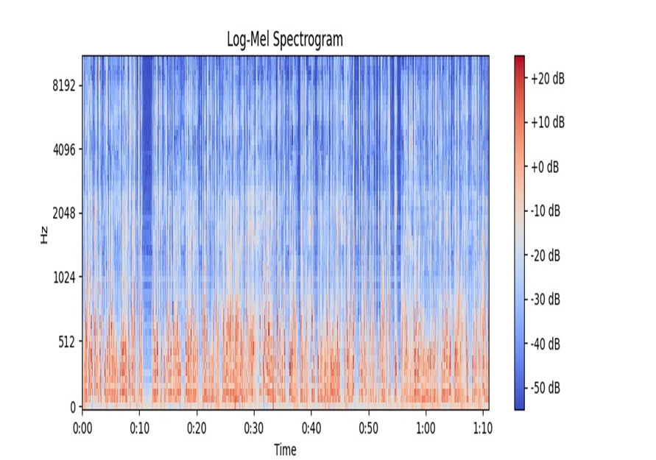
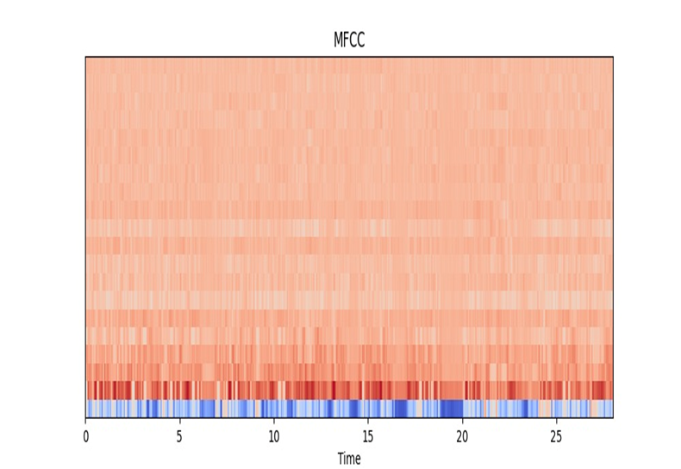
Graphs:

Slide 11
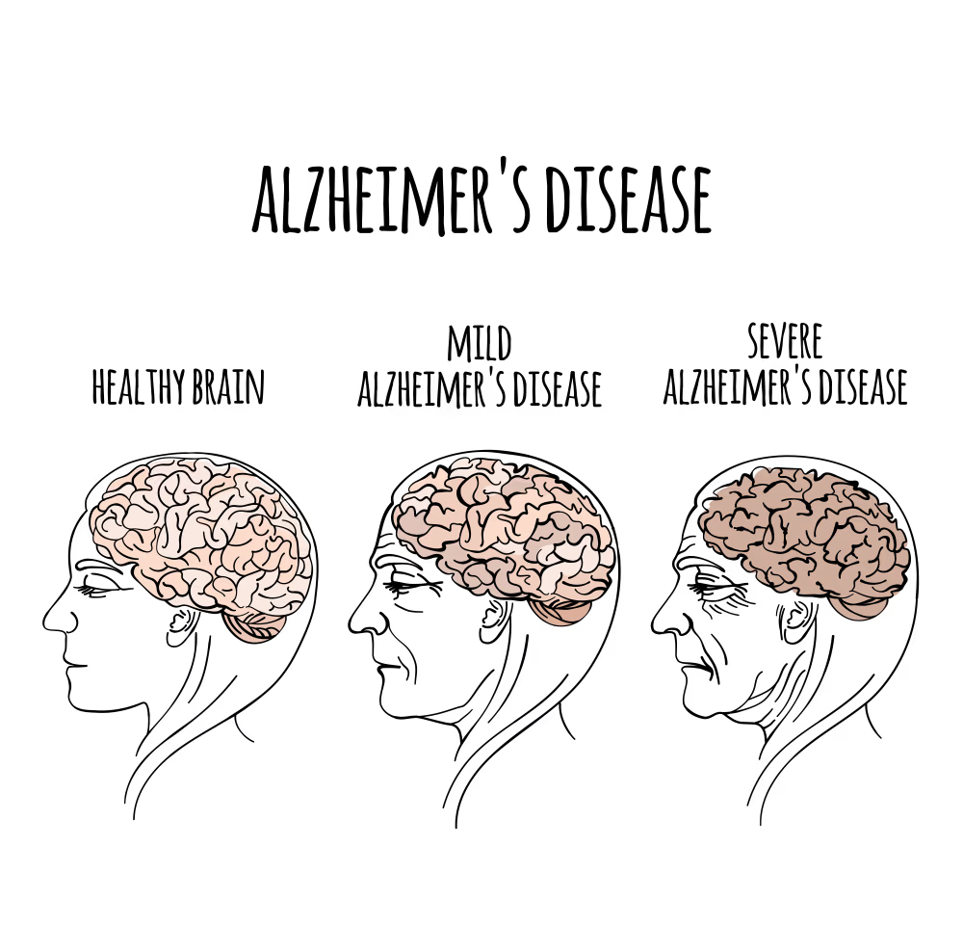
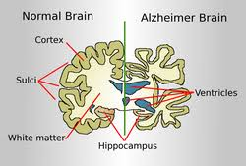
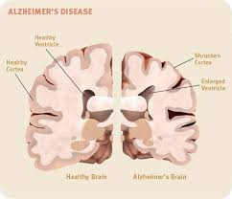
Impact of Dementia on the Brain:

Slide 12
Conclusion:
This project shows that dementia can be identified by analyzing a person’s speech using a BiLSTM deep learning model. The model learns important speech patterns like pauses, hesitation, slow speaking, and irregular rhythm, which are common signs of cognitive decline. By testing the model speaker-wise (on new people it has never seen before), it achieved around 80% accuracy, proving that speech is a useful and reliable indicator for early dementia detection. The system is also connected to a simple web application, where anyone can upload a voice recording and instantly get the result. No medical devices or manual analysis are needed. This project proves that AI-based speech analysis can become a low-cost, easy, and practical tool for early dementia screening in real life.

Slide 13
Thank You

